Slide 1
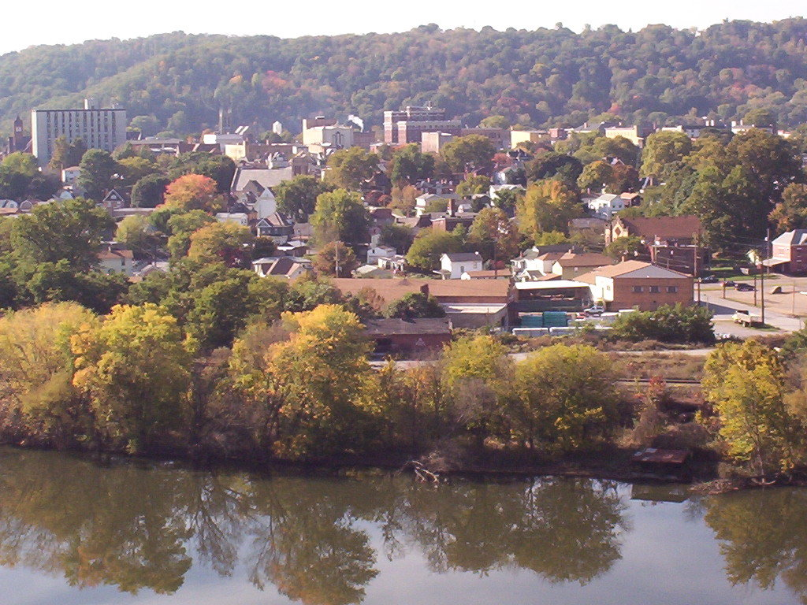
City of Beaver Falls Home Rule Charter
Home Rule Charter Study Commission August 2021

Slide 2
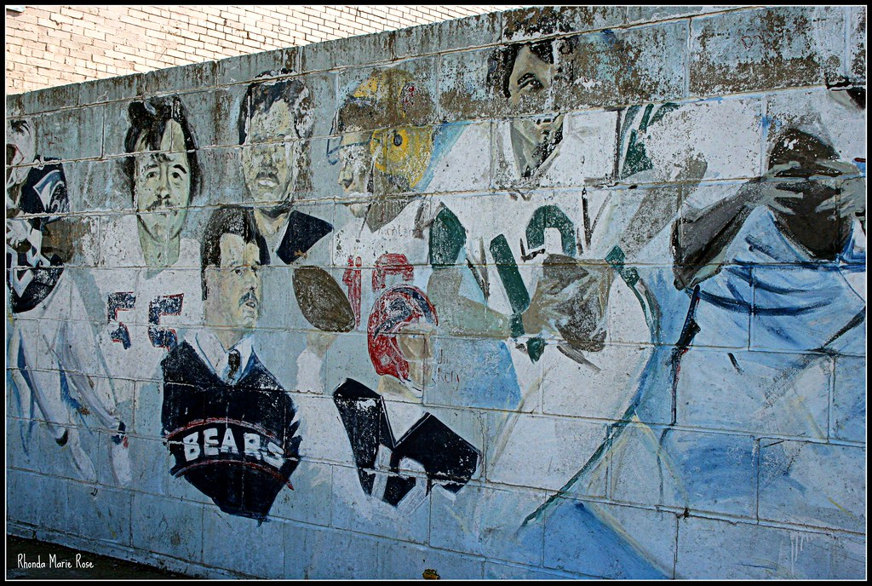
Why Consider Home Rule?
The Problem:
The City has a long and proud history of achievement and triumph – but faced significant challenges in recent years:
Multi-year deficits
Aging infrastructure
Declining property values
Reduction in City personnel
Blight and vacant properties
The Plan:
The City partnered with the PA DCED to prepare a multi-year financial management plan under the STMP Program – the Plan recommended:
Revenue enhancements
Cost containment
Staffing structure and training
Blight strategy study
Home rule charter process

Slide 3
The Home Rule Charter Question to the Voters
In June of 2020, the voters of Beaver Falls approved a ballot question to study the existing form of government and to consider the advisability of the adoption of a new charter that would enable local control of their City government.
A Home Rule Charter Government Study Commission of seven (7) members was elected as part of that referendum ballot.
Home Rule Study Commission Members
Regina Jones, Chairperson
Michael Anderson
Kirsten Bestor
Doug Carson
Jerry Ford
Neal McDowell
Bethany Warren
Ray Gutowski, Alternate

Slide 4
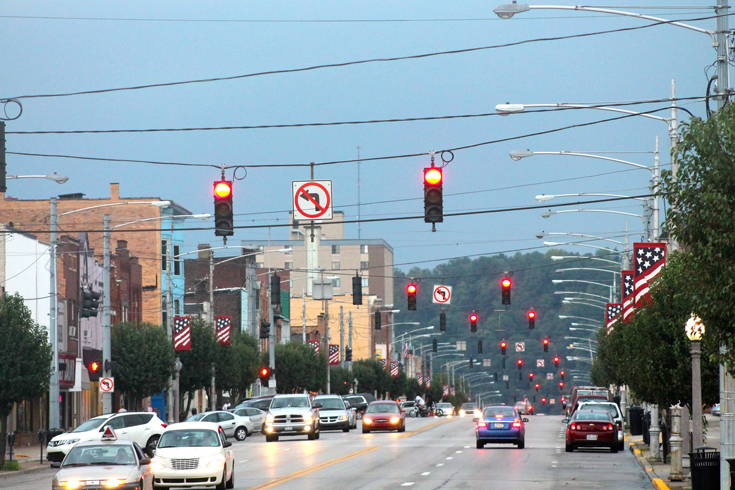
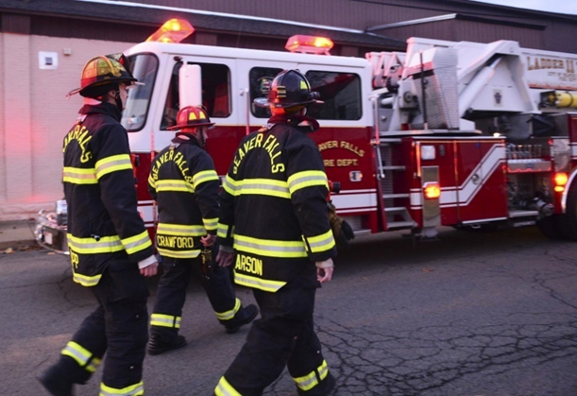
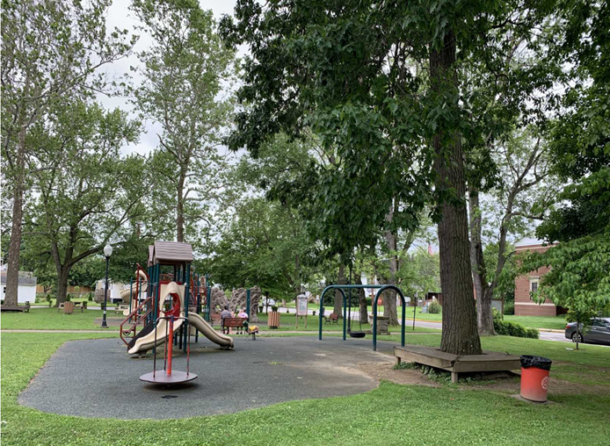
The Questions
What is Home Rule?
How is It Different from the Current City Code?
Why is it Good for the City?
How Will Things Change
Questions??

Slide 5
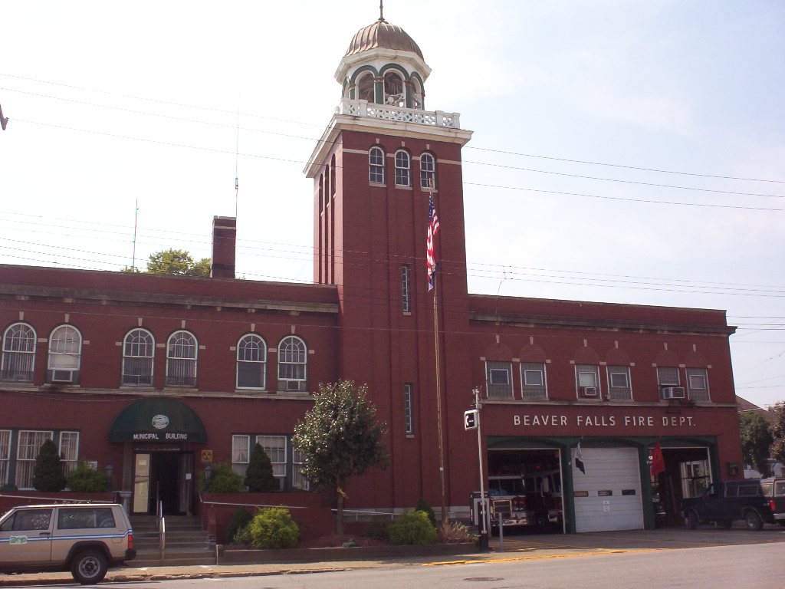
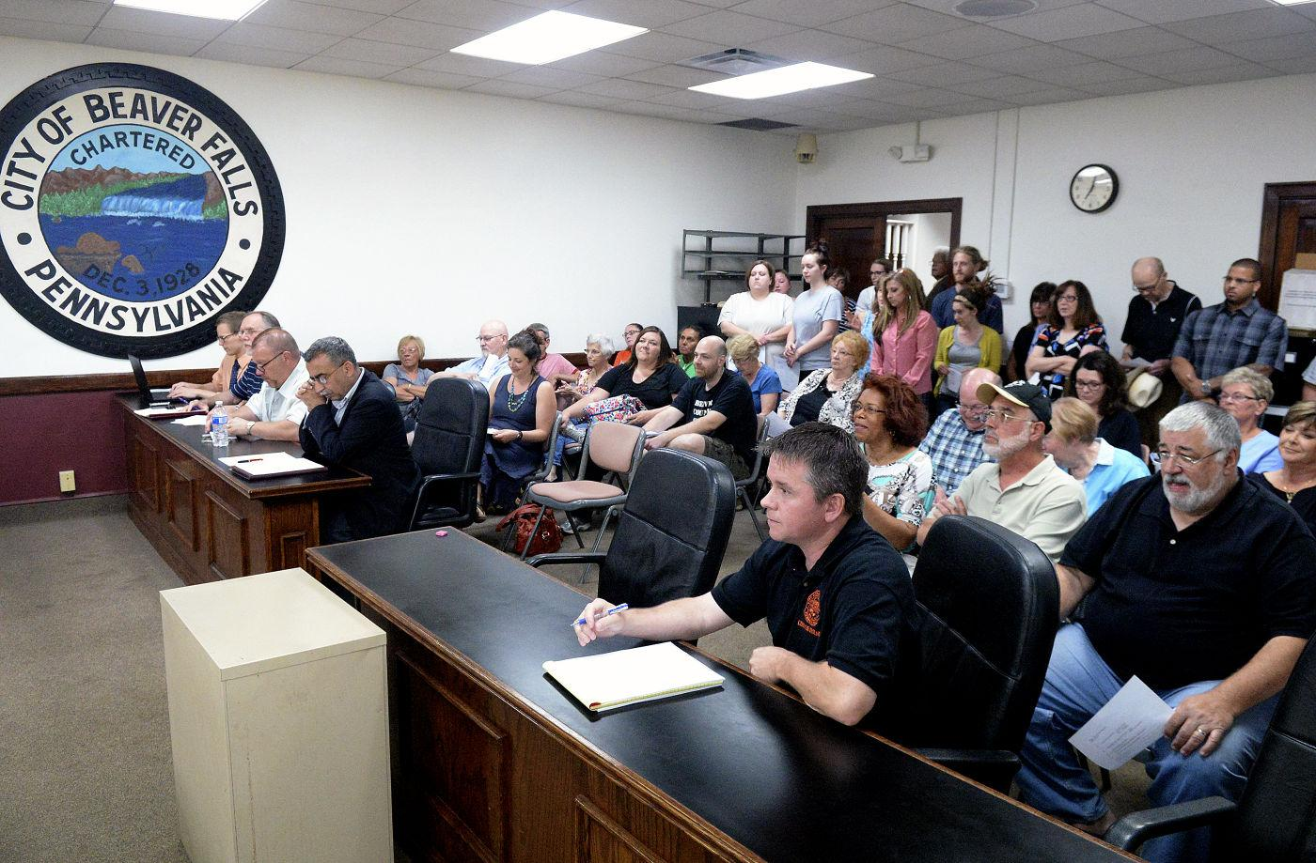
What is Home Rule?
What is Home Rule?
Under Home Rule, the basic authority to act in City affairs is transferred from state laws controlled in Harrisburg to a local Charter adopted and amended by the City voters. Under the current Third Class City Code, a City can do only what is permitted by law. Under Home Rule, the people of Beaver Falls can control how their government is structured for the future.
Home Rule is “by the people.”

Slide 6
The Charter Addresses How City Government Will Be Structured
Mayor
Police Department
Public Affairs
Council Member
Council Member
Council Member
Council Member
Accounts and Finance
Public Safety
Parks and Property
Public Works
City Controller
City Treasurer
Council members act as Department Directors.
City Controller and City Treasurer are elected independently.
City Departments lack coordination.
Council members take on both administrative and policy making duties.
Council members may or may not be qualified to run departments.
City Government Under the Current Third Class City Code

Slide 7
The Charter Addresses How City Government Will Be Structured
Council members are policy makers - adopt legislation.
Elected City Controller and City Treasurer positions are eliminated.
City Manager oversees City Departments.
Chief Financial Officer oversees all financial management.
Qualifications are established for all positions.
City Council Mayor 4 Council Members
Solicitor
City Manager
City Engineer
City Clerk
Police Department
Fire Department
Chief Financial Officer
Public Works
Code Enforcement Community Development
Finance Department
City Government Under Proposed Charter

Slide 8
The Charter Includes Strict Financial Management Standards and More Transparency
The Proposed Charter Requires:
Budget Message in Plain Language
Adopted Budgets for Every Fund
City Information Site for All Proposed Legislation
Capital Improvement Plan Presented at Public Meeting
Operating Budget Adopted at Public Meeting
Flexibility in Taxing Options
Mandatory Annual Independent Audit
All Payments Approved by Council with Live Signatures
Formal Purchasing and Procurement Ordinance Required
Bidding and Contracts Must Be Consistent with the PA Department of Labor and Industry
Taxing Flexibility is an important feature of the proposed Home Rule Charter. Currently, the City is at its taxing limits except for property taxes. Right now, the only option for raising revenue to support City services is to raise the property millage rate. Under the Proposed Charter, the City would have the option to rely more on other revenue sources like earned income tax or deed transfer tax instead of requiring an increase to property taxes. This makes the taxing structure more fair.

Slide 9
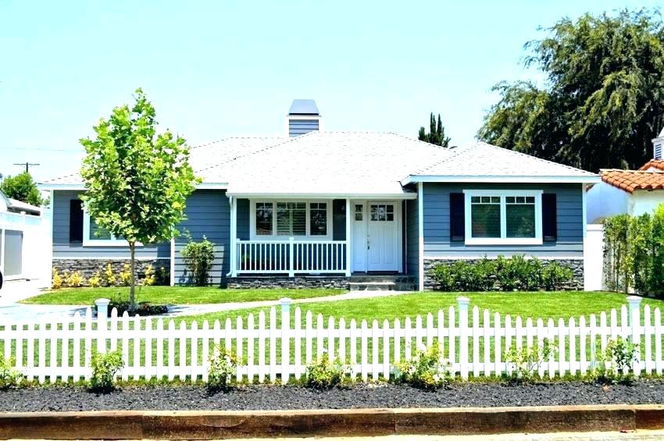
Taxing Flexibility Shifts Some Of The Property Tax Burden to Wage Earners

Slide 10
Earned Income Tax Example A Fair Way to Levy Taxes
Raising the earned income tax by 0.5% would cost the taxpayer $50.00 per $10,000 earned.
Based on the Median Income of Beaver Falls residents which is $35,368:
The 0.5% increase would result in $176.84 in increased earned income tax per year.
This would relieve some of the pressure on property owners who are on fixed incomes.

Slide 11
The Charter Sets High Standards for All Personnel
The Proposed Charter Requires:
The City Manager to oversee all departments.
Council to adopt a personnel ordinance establishing a personnel system.
Department Directors to have the proper certifications, experience, and credentials.
All employees to be hired based on merit.
All fire and police employees to be hired based on Civil Service Rules and Regulations.
The personnel ordinance cannot conflict with collective bargaining agreements.
City employees may not engage in political activity.
City employees may not run for political office.
City employees may not accept gifts from persons who do business with the City.

Slide 12
The Charter Provides for More Citizen Input and Control
Initiative
Citizens may propose ordinances by Petition.
Citizens may propose the repeal of ordinances by Petition.
If Council does not adopt the ordinance, the Petitioners may take the ordinance to Referendum
Referendum
Petitioners may take ordinances to voter referendum.
The voters will have the opportunity to vote for or against the ordinance.
If the ordinance is approved, it becomes local law.
The Charter can be changed by Referendum.

Slide 13
What Home Rule Communities Can’t Do
Make laws contrary to:
United States Constitution
Pennsylvania Constitution
State Laws
Laws that are “uniform and applicable in every part of the Commonwealth.”
Home Rule Communities Must Follow:
Labor Laws
Environmental Laws ( Stormwater Management)
Municipalities Planning Code
Crimes Code
Vehicle Code
Sunshine Law

Slide 14
The Schedule for Adoption
Jul – Aug
Draft Charter
Public Meetings to take Public Comment
September 2
Submit Charter and Final Report to Election Bureau
Sep - Oct
Public Education
And Outreach
November 2
Election Day

Slide 15
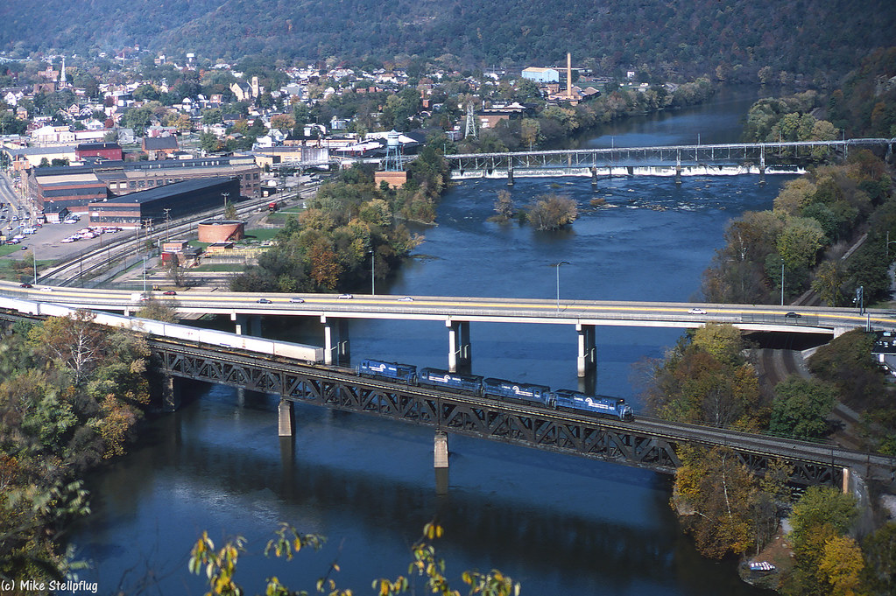
Questions
Your questions and comments help us to improve the quality of our work and enhance the future for Beaver Falls residents.
Thank you for asking!

Slide 16
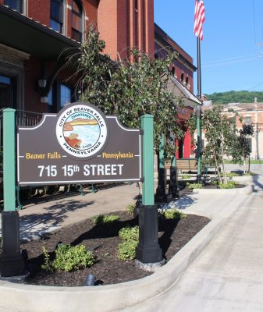
Thank you
The Beaver Falls Home Rule Government Study Commission
For more Information about Home Rule and the Proposed Charter visit:
Our Website
Our Facebook Page
Take Our Survey:
https://www.surveymonkey.com/r/3XFJFNV

